Slide 1
Speed Mathematics
Vedic Mathematics
By
PRATYUS PRATYE

Slide 2
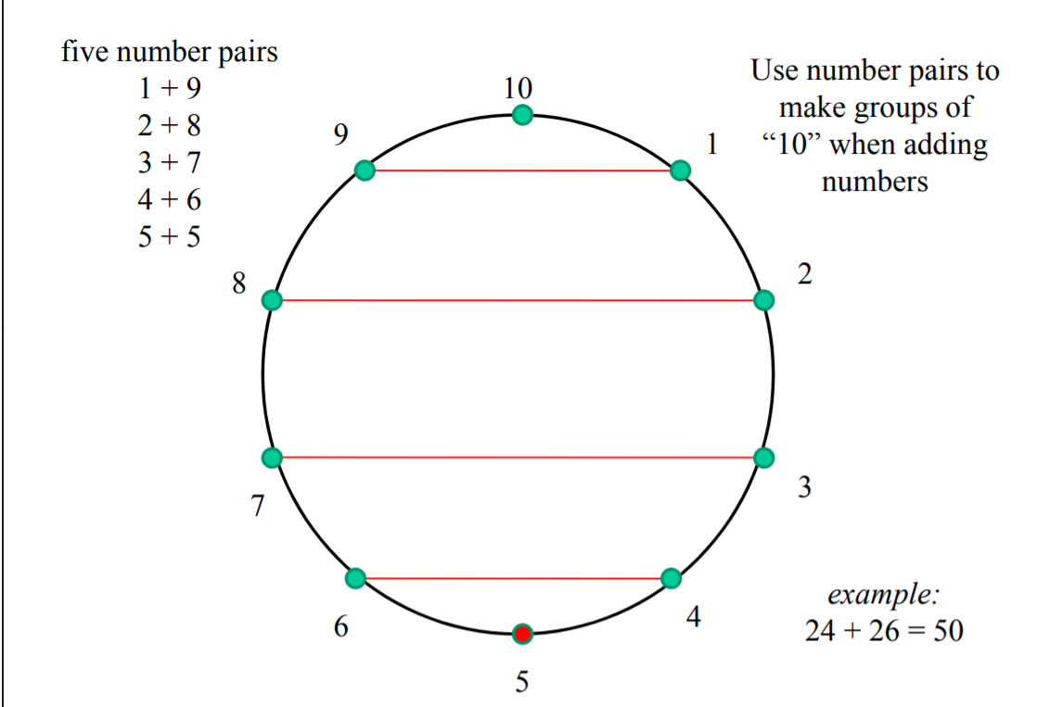
The Ten Point Circle

Slide 3
Adding a List of Numbers
Example: 7 + 6 + 3 + 4
The list can be sequentially added as follows
7+6 is 13,
13+3 is 16
And 16+4 is 20
By Completion or Non-Completion
You could look for number pairs that make multiples of 10
7+3 is 10, 6+4 is 10 , 10+10 is 20 ,
Solve
48 + 16 + 61 + 32

Slide 4
Subtracting Near a Base
When subtracting a number close to a multiple of 10, Just subtract from the multiple of 10 and correct the answer accordingly
Example
53 – 29
29 is close to 30, just 1 lower,
So subtract 30 from 53 making 23
Then add 1 to make 24
53 – 29 = 53 – (30 – 1) = 53 – 30 + 1 = 23 + 1 = 24
By Completion or Non-Completion → (53 – 30) + 1 ↓ (23) + 1 24 ↓
mentally 53 – 29 = 53 – (30 – 1) = 53 – 30 + 1 = 23 + 1 = 24
This process can be done mentally
Example 45 – 18
45 – 18 = 45 – (20 – 2) = 45 - 20 + 2 = 25 + 2 = 27

Slide 5
Doubling and Halving
Mentally Multiplying and Dividing by 2
Mentally Multiplying and Dividing by 4 and 8
sutras Proportionately Mentally Multiplying and Dividing by 5, 50 and 25
Using Number Relationships to Simplify a Problem

Slide 6
Doubling
Adding a number to itself is called Doubling
2 3 + 2 3
Proportionately 2 + 2 → 4 6 ← 3 + 3
46
Mentally, we can double each column and then combine results
5 8 + 5 8 ← double 50 and add double 8
1 1 6
Grouping columns may simply the problem
2 6 3 + 2 6 3
5 2 6

Slide 7
Multiplying by 4 and 8
Doubling can be used to multiply by 4 just double the number twice Proportionately
35 x 4 = (35 x 2 ) x 2 so, 35 x 4 = 70 x 2 = 140
similarly, 163 x 4 = 326 x 2 = 652
Doubling can be used to multiply by 8 just double the number three times
35 x 8 = ( (35 x 2 ) x 2 ) x 2
so, 35 x 8 = 70 x 4 = 140 x 2 = 280
similarly, 163 x 8 = 326 x 4 = 652 x 2 = 1304

Slide 8
Halving
Halving is the opposite of Doubling
Proportionately Half of 42 is 21
just half each column
Half of 56 is 28
just half 50 and half 6 then add Mentally,
The problem can be “broken” into two problems
736 = 700 + 36 half each of these and combine
350 + 18 = 368

Slide 9
Dividing by 4 and 8
Halving can be used to divide by 4 just half the number twice
72 ÷ 4 = (72 ÷ 2 ) ÷ 2 so, 72 ÷ 4 = 36 ÷ 2 = 18
similarly, 164 ÷ 4 = 82 ÷ 2 = 41
Halving can be used to divide by 8 just half the number three times
72 ÷ 8 = ( (72 ÷ 2 ) ÷ 2 ) ÷ 2 so, 72 ÷ 8 = (36 ÷ 2) ÷ 2 = 18 ÷ 2 = 9
similarly, 504 ÷ 8 = 252 ÷ 4 = 126 ÷ 4 = 63

Slide 10
Multiplying by 5, 50 and 25
Multiply by 5 by multiplying by 10 and halving the result
26 x 5 = ( 26 x 10 ) ÷ 2 = 260 ÷ 2 = 130
Multiply by 50 by multiplying by 100 and half the result
It’s easy to multiply by 10 and 100
Make use of this 43 x 50 = ( 43 x 100 ) ÷ 2 = 4300 ÷ 2 = 2150
Multiply by 25 by multiplying by 100 and half the result twice
68 x 25 = ( 68 x 100 ) ÷ 4 = 6800 ÷ 4 = 3400 ÷ 2 = 1700

Slide 11
Dividing by 5, 50 and 25
Divide by 5 by doubling and dividing the result by 10
320 ÷ 5 = ( 2 x 320 ) ÷ 10 = 640 ÷ 10 = 64
Divide by 50 by doubling and dividing the result by 100
It’s easy to divide by 10 and 100! Make use of this!
850 ÷ 50 = ( 850 x 2 ) ÷ 100 = 1700 ÷ 100 = 17
Divide by 25 by doubling twice and dividing the result by 100
325 ÷ 25 = ( 325 x 4 ) ÷ 100 = 1300 ÷ 100 = 13

Slide 12
Proportionately
We know certain number facts well, such as 8 x 7 = 56
But given the problem 16 x 7, we may use long multiplication,
Instead, proportionately allows us to use our number facts along with halving and doubling
16 x 7 = 2 x (8 x 7) = 2 x (56) = 112 all of which can be done mentally!
Similarly,
18 x 14= (2x9) x (2x7) = 4 x (9x7) = 4 x 63 = 2 x 126 = 252

Slide 13
Digit Sums
A Digit Sum is the sum of all of the digits of a number and is found by adding all of the digits of a number
If the sum of the digits is greater than 9, then sum the digits of the result again until the result is less than 10
The Digit Sum of 35 is 3+5 = 8
The Digit Sum of 142 is 1+4+2 = 7
The Digit Sum of 57 is 5+7 = 12 → 1+2 = 3
So the Digit Sum of 57 is 3
The Digit Sum of 687 is 6+8+7 = 21 → 2+1 = 3
So the Digit Sum of 687 is 3
Keep finding the Digit Sum of the result until it’s less than 10
0 and 9 are equivalent!

Slide 14
Checking with Digit Sums
Both Addition and Multiplication preserve Digit Sums
2 1 + 1 4=35
2 6 + 3 5 =61
If the sum of the Digit Sums does NOT equal The Digit Sum of the sum, then there’s a problem!
2 1 x 1 4 =294
If the product of the Digit Sums does NOT equal The Digit Sum of the product, then there’s a problem!

Slide 15
Digit Sums of Perfect Squares
All Perfect Squares end in 1, 4, 5, 6, 9 or 0 and
digit sums are 1, 4, 7 or 9
4539 ends in 9 digit sum is 3 Therefore, 4539 is not a perfect square
5776 ends in 6 digit sum is 7 Therefore, 5776 may be a perfect square

Slide 16
Number Splitting
Quick mental calculations can be performed more easily if the numbers are “split” into more manageable parts
Example
3642 + 2439
36 42 + 24 39 = 60 81
This sum can look somewhat daunting “split” into two more manageable sums Number Splitting
The “split” allows one to add “36+24” and “42+39”, both of which can be done mentally
Think about where to place the “split” line. It’s often best to avoid number “carries” over the line
342 + 587
3 42 + 5 87
9 29 carry → 1 34 2 + 58 7 92 9 a carry of “1” over the line is required No carry is required

Slide 17
The same can be done for subtraction also!
3642 - 2439
36 42 - 24 39
12 03
Number Splitting 263 The “split” allows one to subtract “36-24” and “42-39”, both of which can be done mentally
The “split” may require more “parts” Number Splitting
3015 ÷ 5 =603
15 ÷ 5= 03
30 ÷ 5= 6

Slide 18
Multiplying Numbers Just Below 100

Slide 19
Multiplying Numbers Just Above 100

Slide 20
Multiplying Numbers on Either Side of 100

Slide 21
Multiplying Larger Numbers
EXAMPLE
672x998

Slide 22
Proportionately
EXAMPLE
212x104
92x46

Slide 23
Multiplying Numbers Near Different Bases
EXAMPLE
94x9997
10006x1002

Slide 24
Squaring Numbers Near a Base
EXAMPLE
94
1005

Slide 25
Special Multiplication

Slide 26
Multiply by 11

Slide 27
When 2-digit numbers start with the same digit and their last digits sum to 10
EXAMPLE
32 X 38

Slide 28
When 2-digit numbers end with the same digit and their first digits sum to 10
EXAMPLE
24x84

Slide 29
When multiplying by a number with all digits equal to “9”
EXAMPLE
32 X 99

Slide 30
General Multiplication

Slide 31
Multiplying 2-Digit Numbers
Criss Cross Method
EXAMPLE
24x43
46x52

Slide 32
Multiplying 3-Digit Numbers
EXAMPLE
Find 504 x 321
Find 123 x 321
Find 617 x 893

Slide 33
Squaring

Slide 34
Squaring Numbers Ending in 5

Slide 35
Squaring Numbers Near 50
EXAMPLE
54
48
53
46

Slide 36
General Squaring( a2, 2ab, b2)
EXAMPLE
34
56
123
412

Slide 37
Special Division

Slide 38
Division by 9

Slide 39
Division by 9 with Carries
EXAMPLE
3172
555
6153

Slide 40
Division Below a Base Number
Drop 2 (the first digit) 2. Create 12 = 88 3. Multiple 12 by 2 = 24 4. Add 35 and24
235 ÷ 88 211 ÷ 75
88 ) 2 3
2 5 9

Slide 41
76 ) 2 1 1
2 5 5 0
2 6 1

Slide 42
1121123 ÷ 8989
8989 ) 1 1 2 1 1 2 3
1 0 1 1 1 0 1 1
2 0 2 2
4 0 4 4
1 2 4 6 4 8 7

Slide 43
THANKS
“WISH YOU A GREAT CAREER AHEAD”

